Slide 1
HTML
Hyper Text Markup Language

Slide 2
Examples and Resources
HTML Examples
Forms and Tables
https://gist.github.com/gtjames/fc84b1e71fcc30a9a01115b4de27a3ee
Various HTML and CSS examples
https://github.com/gtjames/HTML-Basics
Other Resources
https://www.linkedin.com/learning/html-essential-training-4
Just for practice
https://www.w3schools.com/html/default.asp

Slide 3
HTML
HTML stands for Hyper Text Markup Language
HTML is the standard markup language for creating Web pages
HTML describes the structure of a Web page
HTML consists of a series of elements
HTML elements tell the browser how to display the content
HTML elements label pieces of content such as "this is a heading", "this is a paragraph", "this is a link", etc.

Slide 4
Document Format
<!DOCTYPE html>
Heads up to browser ‘I’m a web page!’
The <HTML> </HTML> tags ‘wrap around’ the whole document
There are two main sections for the document
<head> … </head> contains information about the page
<body> … </body> This is EVERYTHING the user sees

Slide 5
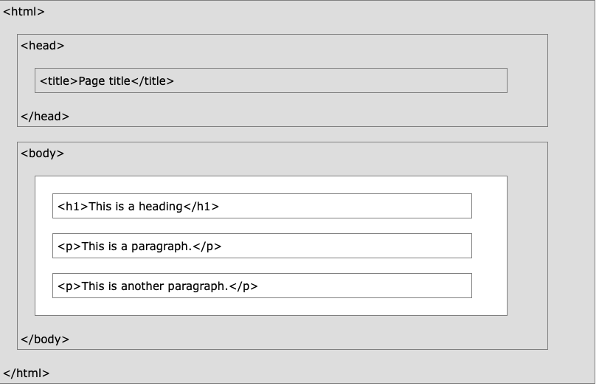
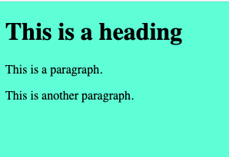
Your first Web page
<!DOCTYPE html> <html> <head> <title>Page Title</title> </head> <body> <h1>This is a heading</h1> <p>This is a paragraph.</p> <p>This is another paragraph.</p> </body> </html>

Slide 6
HTML Elements
With very few exceptions an HTML element has
an opening tag <tagname>
Inner content
And a closing tag </tagname>
<tagname>Content goes here...</tagname>
The closing tag is a forward slash and the tag name
An HTML Element is the combination of all three parts

Slide 7

Common HTML Elements
H1 – H6 Header (1 is big text, 6 is smaller)
P Paragraph just text
A ‘anchor’ tag for links
Strong/em bold text/emphasized (italic) text
Code formats text as ‘code’
https://www.w3schools.com/tags/default.asp

Slide 8
Text Elements
<h1> Heading </h1>
<h3> Heading </h3>
<h6> Heading </h6>
<p> text with the default font </p>

Slide 9
Grouping Elements without styling they do nothing
<div> fill in with whatever you like </div>
This is a ‘block’ tag
The div will have a line break before and after the element
<span> similar to the div tag </span>
But the span tag is an ‘inline‘ tag
Whatever goes inside the tags will be on the same line

Slide 10
Grouping Elements without styling they do nothing
<aside> just like the other guys </aside>
Defines content aside from the content it is placed in.
Should be indirectly related to the surrounding content.
The <aside> content is often placed as a sidebar in a document.
Does not render as anything special in a browser. Use CSS for styling

Slide 11
<aside> same as a div until you add style
<aside> <p> CSS was first proposed by Hakon Wium Lie on October 10, 1994. At the time, Lie was working with Tim Berners-Lee (father of HTML) at CERN. The European Organization for Nuclear Research is known as CERN. Hakon wium lie is know as father of css. </p> <p> <a href="https://www.w3.org/Style/CSS20/history.html">History of CSS</a> </p> </aside>

Slide 12
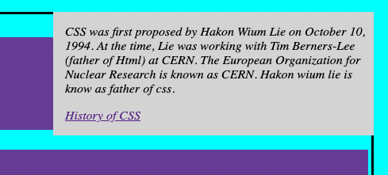
Adding styling to an <aside>
aside { width: 30%; padding-left: 15px; margin-right: 15px; float: right; font-style: italic; background-color: lightgray; }
Margins and Padding.html

Slide 13
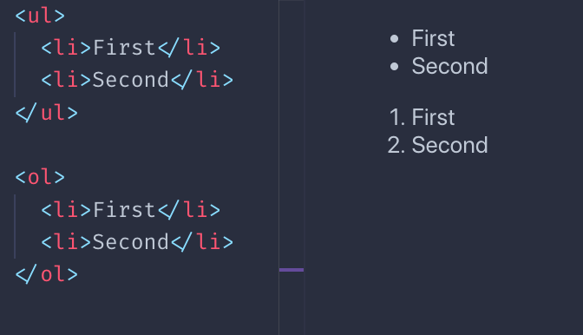
Making Lists

Slide 14
No closing tag no inner text
<br> // adds a new line
<hr> // horizontal line
<img src=“…..”> // image
<input type=“text”> // input field

Slide 15
Attributes
An element can have attributes that complete the design of the element like:
<a href=https://www.cnn.com>Click me to go to CNN</a>
<img src=“\images\UNT.jpg” width=”100px” height=“80px”>
<input type=“number” min=“-10” max=“20” step=“7”>

Slide 16
Tables Tables-Books.html
TABLE
CAPTION
THEAD
TR
TH
TBODY
TR
TD
TFOOTER…

Slide 17
Image element and its associated attributes
<img alt="" src="images/Shang-Chi.gif" width="67px" height="100px">
alt required. Text description for the visually impaired
src wouldn’t be much of an image without an image
width reformats the image to fit the design of your page
height size can be % or px

Slide 18
Anchor element and its associated attributes
<a href="https://www.imdb.com/title/tt0096639"> <img src="images/Lonesome Dove.jpg" width="136px" height="201px"> </a>
href the hypertext refenece to another page
Anything in the innerHTML is clickable
<a href="https://www.imdb.com/title/tt0096639"> Take me to IMDb for Lonesome Dove </a>

Slide 19
Form Elements Form-Intro and Form-Checkout.html
Form specifies how the form data will be submitted
Fieldset puts a border around the fields in the form
Legend adds a text string to the border
Input entry field – lots of types. Input gets its own page
Label text before the input field. Click on the text focus goes to the input field
Select Drop down list
Textarea when you post a comment this is a text area element
Button button
Datalist limits what can be entered into an input field

Slide 20
Input types Form-Checkout.html
button
checkbox
color
date
email
file
hidden
image src=“”
month
number
password
radio
range
reset
search
submit
tel
Text (default value)
time
url
week

